Slide 1
Multi-Processor System on Chip Real-Time Face Detection System
JACK WONG
LIN YANG

Slide 2
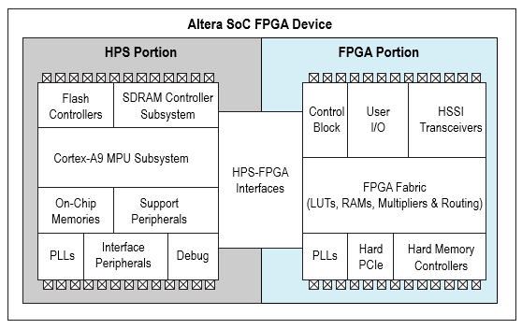
Real-time Face Detection
Goal: Investigate the performance difference between hardware and software component.
HW/SW co-design
Aim: To process 1 image per sec(320*240 pixels)
Software component is implemented based on OpenCV modules and using VHDL to implement the hardware component.
The face detection system is developed on DE1-SOC FPGA board using Linux Ubuntu OS.
Notes:
The purpose of our project is to design a real-time face detection system. Our goal is to enhance the performance of the face detection system by reducing the time to process each image and investigate the performance difference between hardware implementation and software implementation. During our project, we have considered using hardware/software co-design technique to reduce the processing time while maintaining the accuracy. We have used software component to implement the basic structure of the real-time face detection system and we use hardware component to speed up some of the operations. Since the processing time depends on the size of the picture, we have defined 1 second to be the real-time definition for a 320*240 image. For this research, We have used Altera DE1-soc FPGA board with Linux Ubuntu to implement and test our system. We have implemented the software component on the hard processor system running on ARM Cortex Multi core processor. We have considered using AXI bridge protocol to communicate between hard processor system and FPGA fabric. We have implement the software components using OpenCV objection detection modules and using VHDL to implement the hardware component. Block diagram of fpga.

Slide 3
System Overview
Implemented on HPS
Input
Image
Pixel-based
Skin color segmentation
Feature-based
Cascade Classifier
Face region
locating
Face skeleton
Extraction
Noise
Filtering out
Implemented on FPGA
Notes:
Here is the overall system block diagram. We have divided the face detection system into software and hardware component. The basic structure of the real-time face detection system is implemented on the HPS. From various research paper on face detection system, we have concluded that there are two main categories of face detection algorithm which is pixel based algorithm and feature based algorithm. Pixel based algorithm searches the entire image to detect the position of a human face while feature based algorithm uses search windows to find how likely the region is a part of the facial features. In the software component, we have implemented skin color segmentation which is a pixel-based algorithm and cascade classifier which is feature-based algorithm.

Slide 4
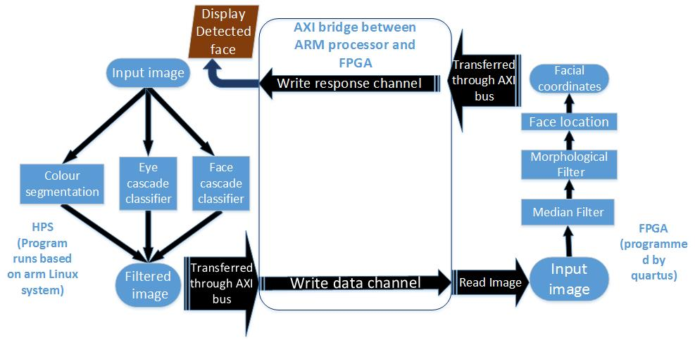
Algorithm Structure
Pixel based algorithm and feature based algorithm.
Notes:
The input image would be pre-processed by software component first and the output image would be transferred to the hardware component using AXI bridge protocol. After the filtered image is processed by hardware component, the output coordinate of input faces would be transferred back to software component to display the output image. In software component, we have implemented both pixel-based and feature-based algorithm to test the advantage and disadvantage of each of these algorithms. In the following section, I will present the implementation and theory of these algorithm and evaluate the limitation of each approaches. The issues we face and why we use skin color. Skin-color is a useful technique to …

Slide 5
Skin Color Segmentation
Pixel-based algorithm.
Human skin tone has a specific color range in different color space.
The color range of human skin is usually very different from the background color.
Based on this fact, we can determine the human skin region by finding the color value of each pixels within an image.
Extract the human skin region from the image
Input
Image
Skin Color
Segmentation
Feature
extraction
Notes:
Skin color segmentation is an pixel-based face detection algorithm.

Slide 6
Colour Space Filter
Skin Color
Segmentation
Assumptions:
Input image can not be greyscale.
Person in the picture cannot be of any unnatural colour.
To increase the accuracy of the face detection without increasing processing time too much, we have implemented 3 different color space filters to detect the skin region within an image.
HSV Color Filter
YCrCb Color Filter
RGB Color Filter
Notes:
Make connection to partial face.

Slide 7
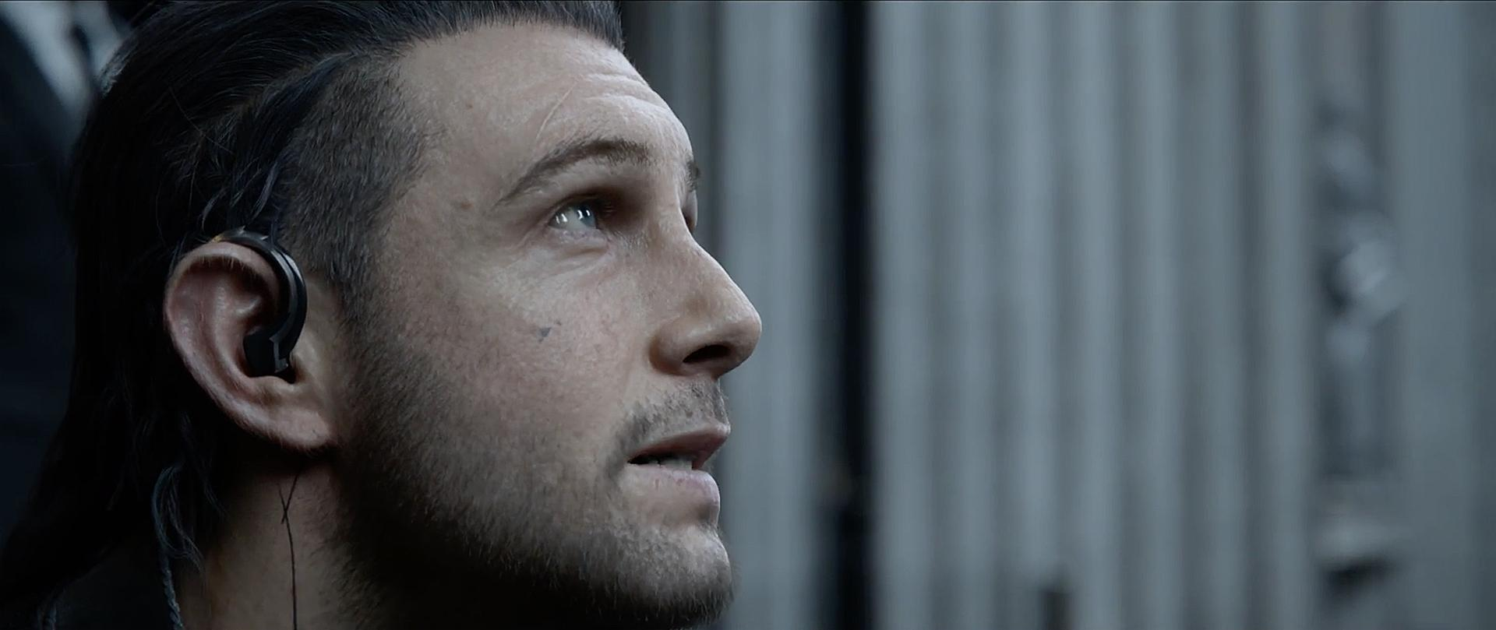
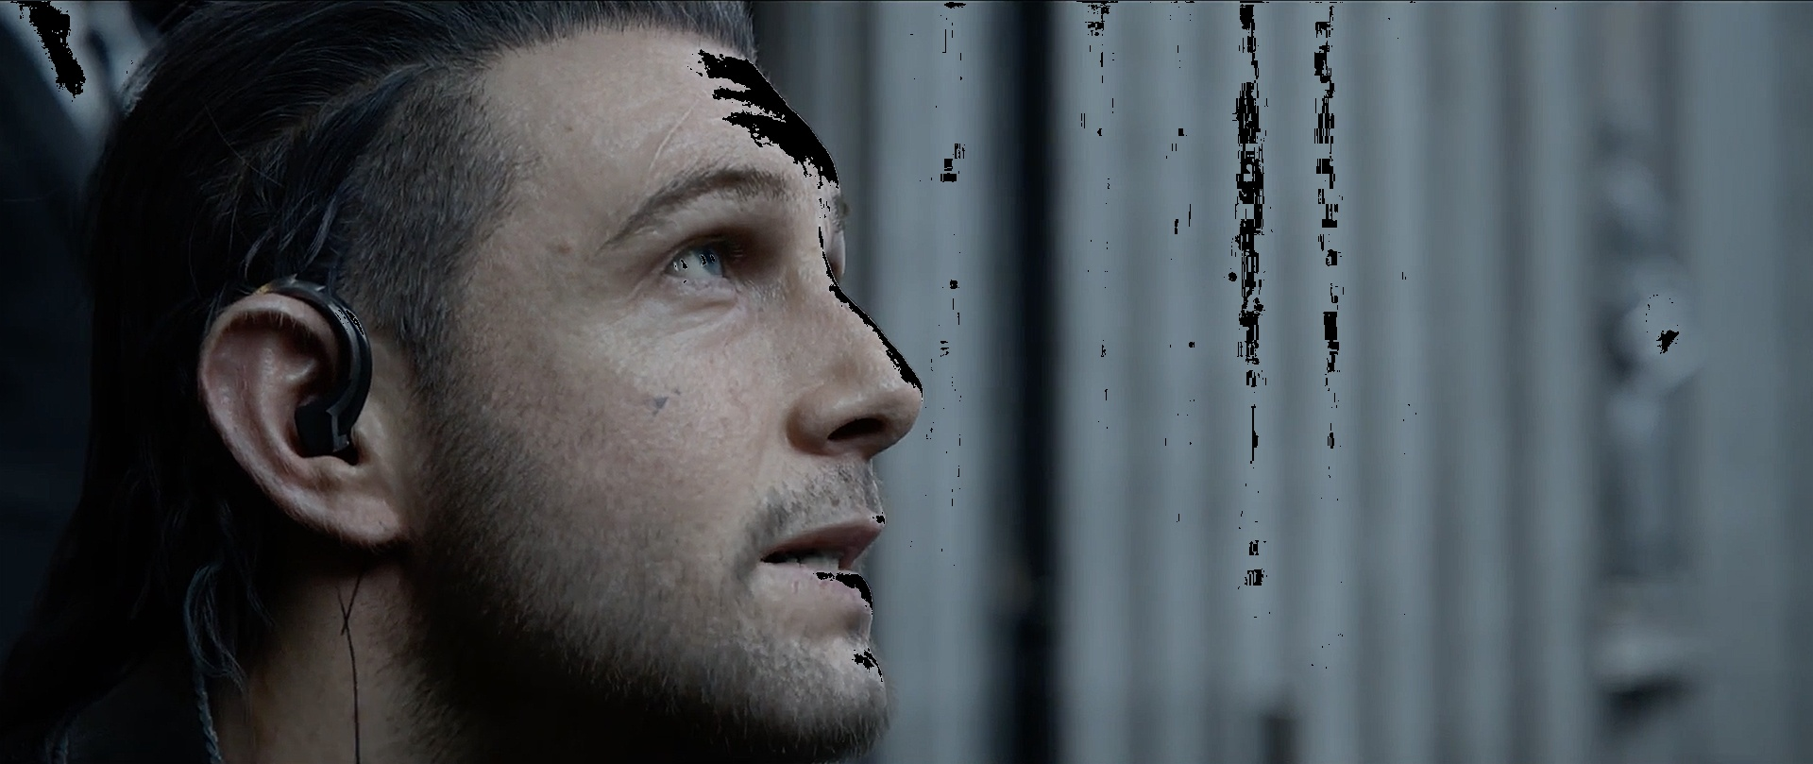
Skin Colour Segmentation - RGB filter
Skin Color
Segmentation
RGB is the most commonly used colour space. It cannot differentiate the effect of luminance but it can still be used to remove out of range skin colour pixels.
0.836G + 44 > B > 0.836G – 14 => Skin
0.78G + 42 > B > 0.79G – 67 => Skin

Slide 8
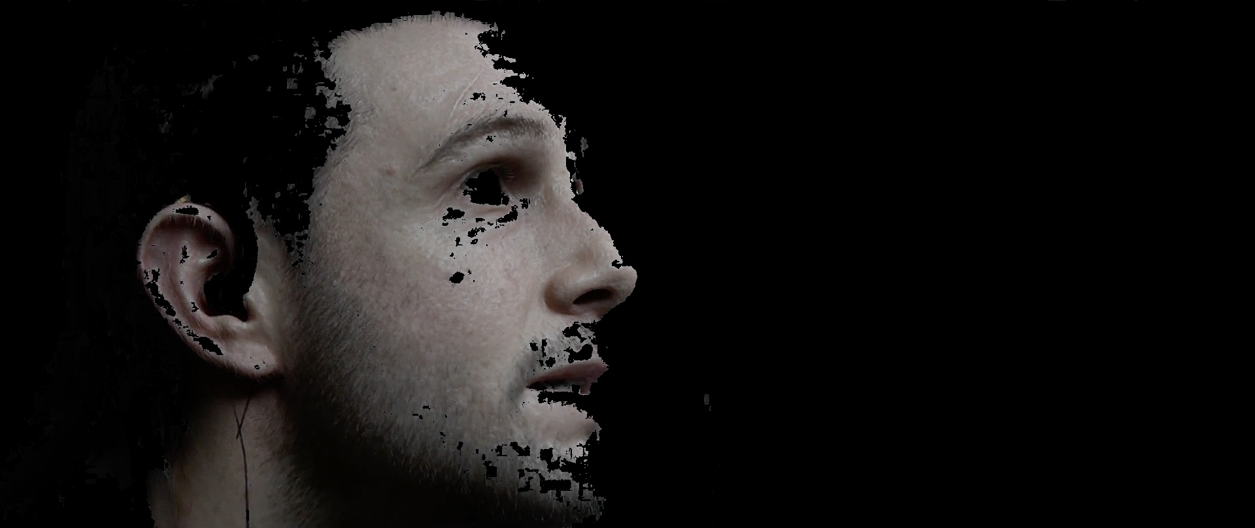
Skin Colour Segmentation - YCrCb filter
Skin Color
Segmentation
YCrCb filter is a type of colour space that are used as a component of pipeline of colour image in digital photography and video system.
Y is the luma component which represents the brightness in an image.
Cr and Cb are the red and blue difference chroma components which represent the colour information.
YCrCb is a way to represent RGB colour information after encoding.
128 > Cb > 102 => Skin
160 > Cr > 125 => Skin

Slide 9
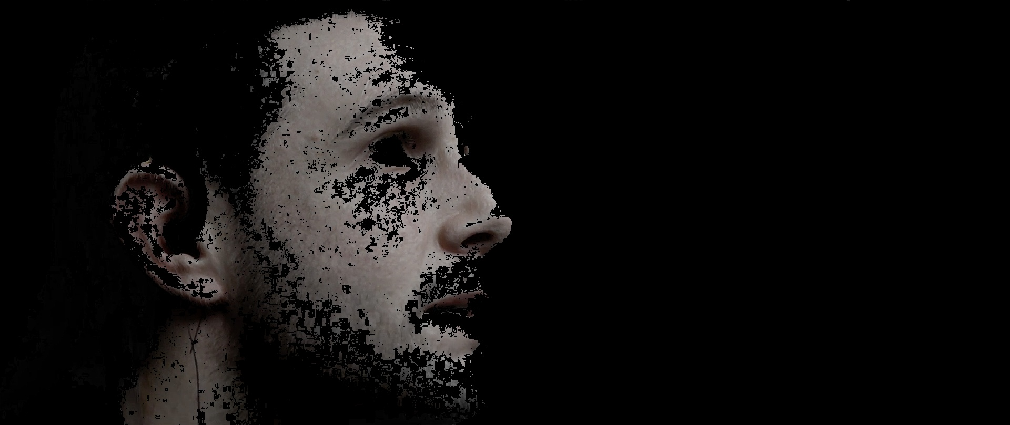
Skin Colour Segmentation - HSV filter
Skin Color
Segmentation
HSV colour space gives information about colours of how a person thinks about colours and how colours are mixed by an artist.
H is hue which shows the basic colour in an image.
S is saturation which shows how the hue is diluted by the white light.
V is value which shows the intensity of the colour.
H value of human skin occupies a narrow range near the maximum and minimum possible values.
255 > H > 240 or 19 > H > 0 => skin
Notes:
RGB color space does not gives luminance.

Slide 10
Skin Color Segmentation - Output
By combining the result from all 3 color filters, the face detection system would extract the skin color pixels from the image.
Advantage:
Able to detect partial face and multi face regions
Limitation:
The computational cost is high since the computational complexity is O(n^2). The system loops through every pixels of an image.
Input picture could not be of greyscale otherwise the output of this algorithm would not be accurate.
Input faces can not wear any unnatural color paint.

Slide 11
Face Features extraction
Input
Image
Skin Color
Segmentation
Feature
extraction

Slide 12
Cascade Classifier
Feature
extraction
Cascade Classifier is a feature-based algorithm.
It is a machine learning approach and each classifier is trained from many positive and negative images.
Our Face Detection System uses eye and face cascade classifier to increase the accuracy of detecting facial features.
Advantage:
Fairly Accurate with some false positive
Feature-based algorithm operates much faster than pixel-based system.
Input faces can wear accessories (i.e. glasses)
Disadvantage:
Unable to detect partial face features
Notes:
Need to make them understand each

Slide 13
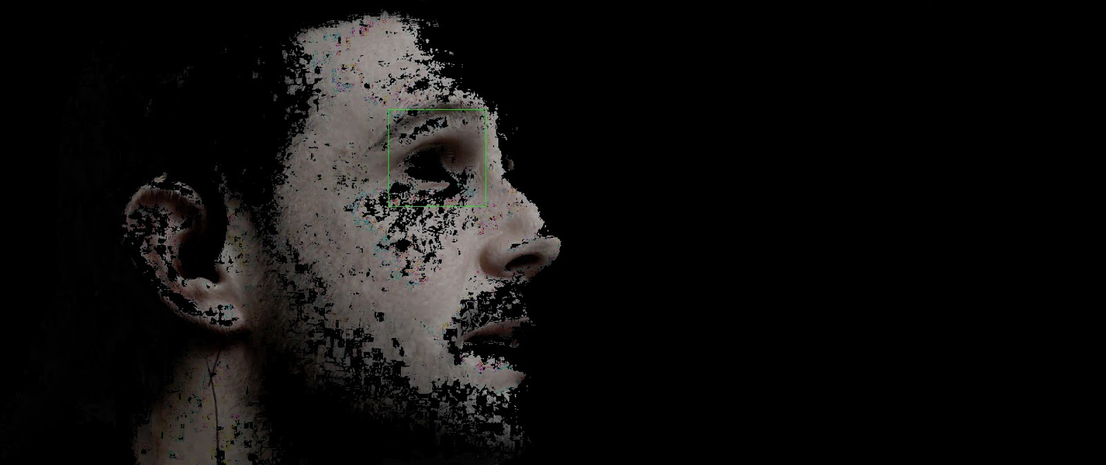
Experimental Result

Slide 14
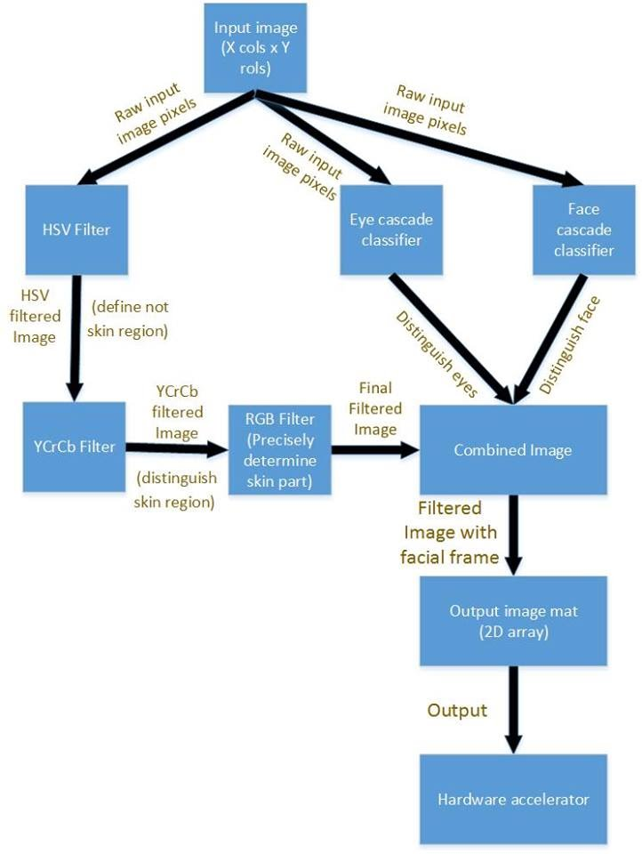
Work Flow of the SW algorithm
Combine the result of Skin colour segmentation and eye cascade classifier and face cascade classifier.
If 2 out of 3 criteria are satisfied, the result region is a face.
Parallel Processing: Use different process to handle different filters and cascade classifier.

Slide 15
Profile Result
x | y | Skin Color Segmentation | Eye Cascade Classifier | Face Cascade Classifier | total | Detected Face
320 | 240 | 0.21 | 0.41 | 0.49 | 1.11 | Y
640 | 480 | 1.02 | 0.78 | 1.48 | 3.28 | Y
960 | 720 | 1.87 | 2.33 | 3.41 | 7.61 | Y
1280 | 960 | 5.96 | 1.97 | 3.16 | 11.09 | Y
The complexity of our system is O(n^2). The higher the resolution of the input image, the longer the processing time.
By combining Skin Color Segmentation and cascade classifier algorithm, the processing time increase depending on the size of image but the accuracy rate improves.
Our Face Detection system are able to detect partial faces and multiple faces although the accuracy is lower than a whole face detection.
The bottleneck of the system is in skin color segmentation. Hence we have decided to implement skin color segmentation in hardware component.
Notes:
From the profile result , some part need to implement in hardware.

Slide 16
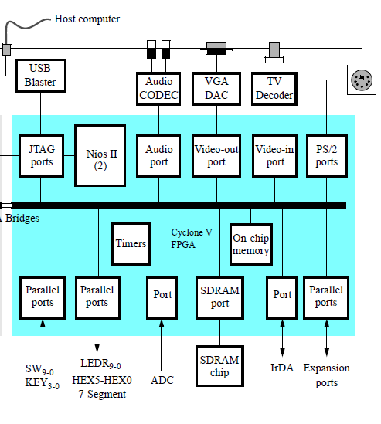
FPGA
Altera Cyclone® V device
JTAG Port
USB-Blaster II onboard for programming;
64MB SDRAM
50MHz clock sources from the clock generator

Slide 17
Hardware Components
The hardware filters that are implemented using VHDL. The main purpose of hardware implementation is to minimize the bottleneck effect on software implementation To assist simulation, we used image processing algorithm in MATLAB to visualize the face region on filtered image.
Input image from HPS
Color segmentation
Noise
Filtering out
Export output location
Facial coordinates locating
Facial skeleton extraction

Slide 18
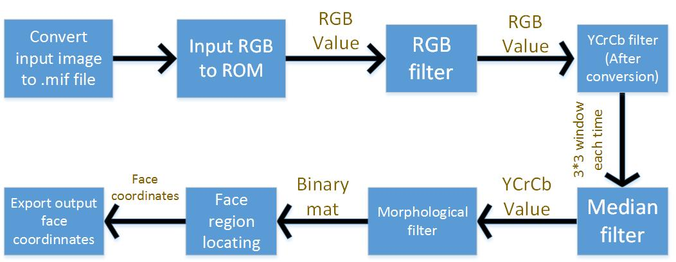
Work Flow of the Hardware algorithm
Median filter is the main bottleneck.
Color Space Filter​
RGB filter
YCrCb filter​
Morphological filter

Slide 19
Skin Color Segmentation (Hardware) - RGB filter & YCrCb filters
Skin Color
Segmentation(HW)
In order to fairly compare the efficiency of image processing on different platform ,we implemented same skin color filter on hardware platform at the same time.
Limitations:
-The input of color segmentation should be colorful, but also it largely depends on the face skin color. It had very low accuracy on extracting some different examples, such as the African American.
-Because of the fixed threshold value.
Notes:
RGB cannot differentiate the effect of luminance hence YCrCb filter is required to furtherly classify color segments where Y is the luma component to distinguish the brightness ,Cb and Cr refer to the chroma components of blue and red.

Slide 20
RGB to YCrCb conversion
Skin Color
Segmentation(HW)
On the other hand ,due to a fact that the parameters for describing color segmentation are different, the RGB values need to be converted to YCrCb parameters before processing(which was automatically done by OpenCV library on SW part).
On software implementation, the RGB to YCrCb conversion was done through OpenCV library which was more convenient and accurate.
Where : Y = 0.299 * R + 0.587 * G + 0.114 * B Cr = 0.500 * R - 0.419 * G - 0.081 * B and Cb= - 0.169 * R - 0.331 * G + 0.500 * B

Slide 21
Noise removal - median filter
The median filter is a nonlinear digital filtering technique, often used to remove noise from an image or signal.
Limitations: The main problem of the median filter is its high computational cost. Hence implemented on FPGA
Notes:
The median filter is designed with streaming architecture. It run through the picture entry by entry, replacing each entry with the median of neighbouring entries in the 3x3 window.
In our project, such noise reduction is a pre-processing step to improve the results of colour segmentation.
Limitations:(for sorting N pixels, the temporal complexity is O(N·log N), even with the most efficient sorting algorithms). When the median filter must be carried out in real time, the software implementation in general-purpose processors does not usually give good results.

Slide 22
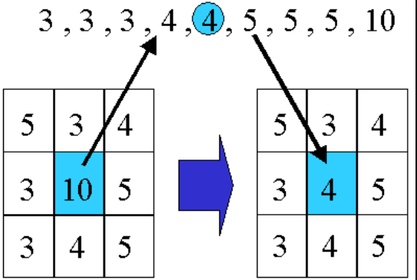
Median filter algorithms
The main idea : Run through the signal entry by entry, replacing each entry with the median of neighboring entries.
The window size that we used is 3x3 .
Thus the computational cost is 9 times greater than other algorithms.
Notes:
The main idea of the median filter is to run through the signal entry by entry, replacing each entry with the median of neighboring entries

Slide 23
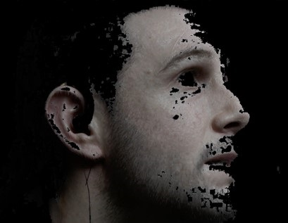
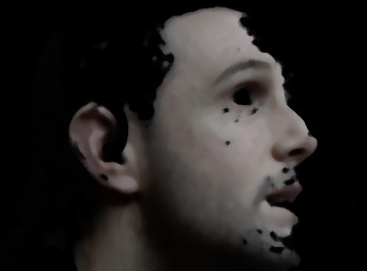
Experimental result of median filter
Before
After

Slide 24
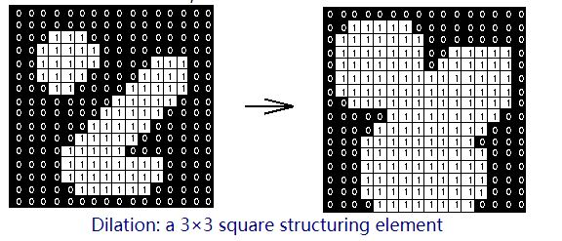
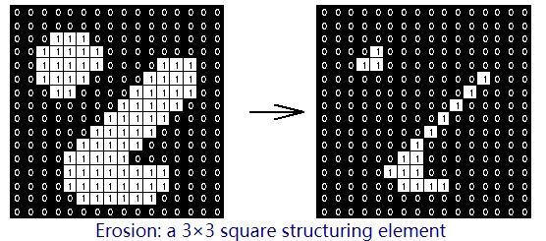
Facial skeleton extraction-Morphological filter
Morphological image processing is a non-linear operation related to morphology of an image.
It consists of four processes: Dilation-Closing--Erosion-Opening.
Limitation: Normally developed for binary images.
Notes:
The image is transformed by filtering out noise and easily seen skeleton.
Limitation: The limitation of morphological filter is that it is normally developed for binary images.It has little effects on color images.

Slide 25
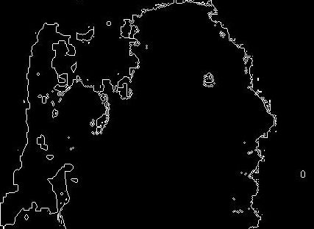
Effect of Morphological filter
Before
After

Slide 26
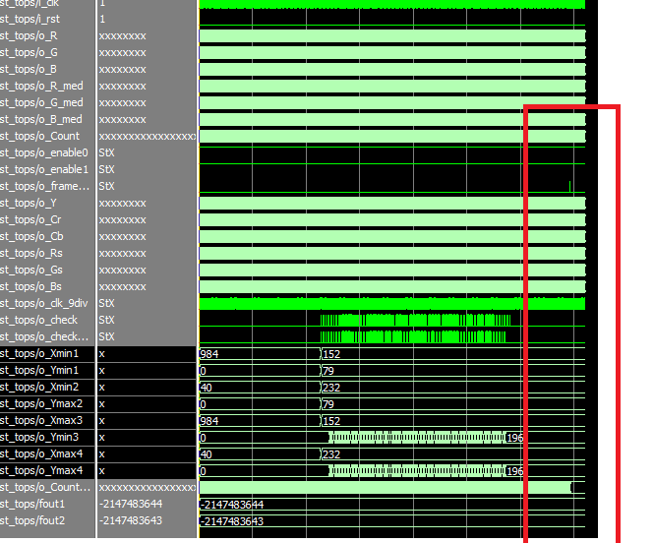
Modelsim simulation
Modelsim was used for simulation. After the face is detected in hardware, the coordinates of the rectangular corner is exported as output that will be shown in Modelsim.
The coordinates will then be substituted into matlab in order to plot the final detected image.

Slide 27
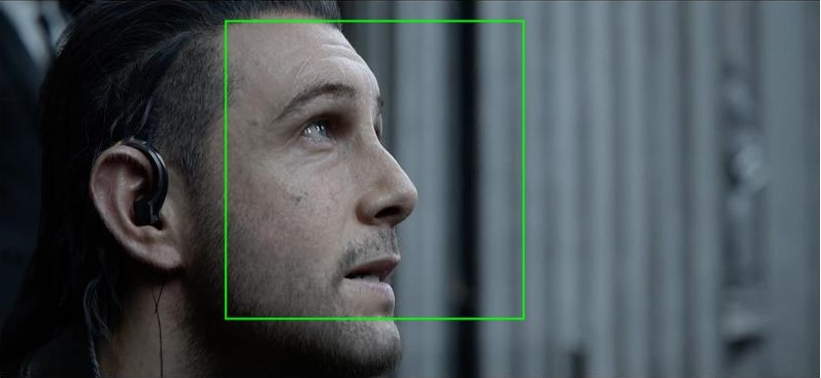
Final output image

Slide 28
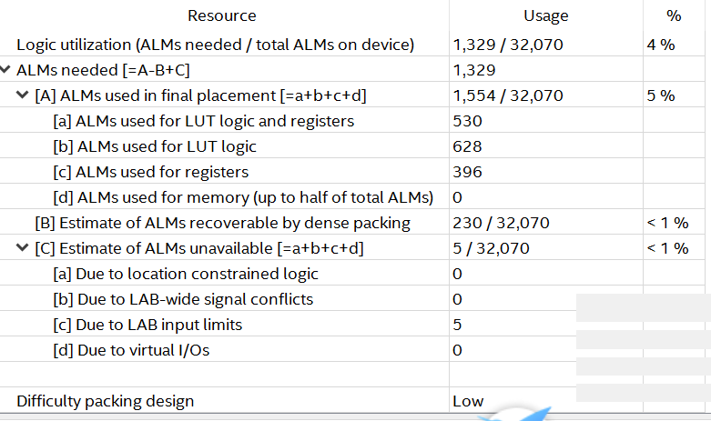
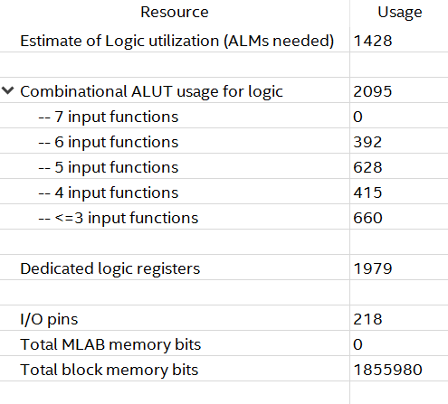
Resouce usage
ALM (adaptive logic module)usage
Notes:
A representative parameter of resource usage in hardware implementation. Only 4% of total ALM are used in FPGA so it is a fair

Slide 29
Conclusion
Embedded implementation of real-time face detection algorithm
The efficiency as well as accuracy could be improved.
The main bottleneck was identified in ARM.
A SW-HW co-design approach to reduce the processing time .
This implementation meets the basic targeted marketing requirements .
Notes:
In this paper, we have presented an embedded implementation of real-time face detection algorithm. The main bottleneck in ARM platform was identified by using execution profiling and then moving some parts of the algorithm into hardware on FPGA. A SW-HW codesign approach was taken into consideration to reduce the processing time of a face detection algorithm while maintaining a high level of accuracy. This implementation meets the basic targeted marketing requirements of real-time face detection.

Slide 30
Future Work
The communication (AXI bus protocol) between HPS system and FPGA was not finished due to limited time where more work should be put on.
Further investigation should be focusing on the interaction between the Cortex A9 cores that we didn’t finish due to limited time.
Future development can consider new applications, such as face recognition.
Notes:
The interaction between two cores will ideally increase much efficiency.
Every thing that is done that is helpful to the project should be included in the report.

Slide 31
Thanks!

Slide 32
Questions?

